Slide 1

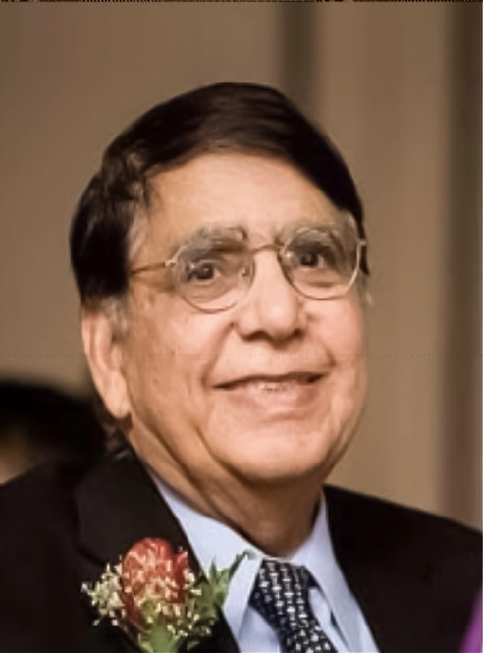
SANA-ANMOL
Sindhi Association of North America-Ali Nawaz Memon
Opportunity Loans
Qarz-e-Hasna, interest-free loans Program
SANA is 501(c)(3). Donations are tax-deductible
Established 2023

Slide 2
The SANA-ANMOL Program is not a family initiative

Slide 3
The SANA-ANMOL Program was initiated and approved by the SANA-EC in 2023

Slide 4
The SANA-ANMOL Program is one of the SANA initiative just like FAME-Fund and SECHAR

Slide 5

Happy 2nd Birthday SANA-ANMOL Program

Slide 6
SANA-ANMOL COMMITTEE 2025
  Aijaz-Ul-Haq Memon (Member)
  Saleem Kazi (Member)
  Zaheer Baloch (Member)
  Ahmer Nadeem Memon (Member)
  Sarfraz Memon (Chairman)

Slide 7
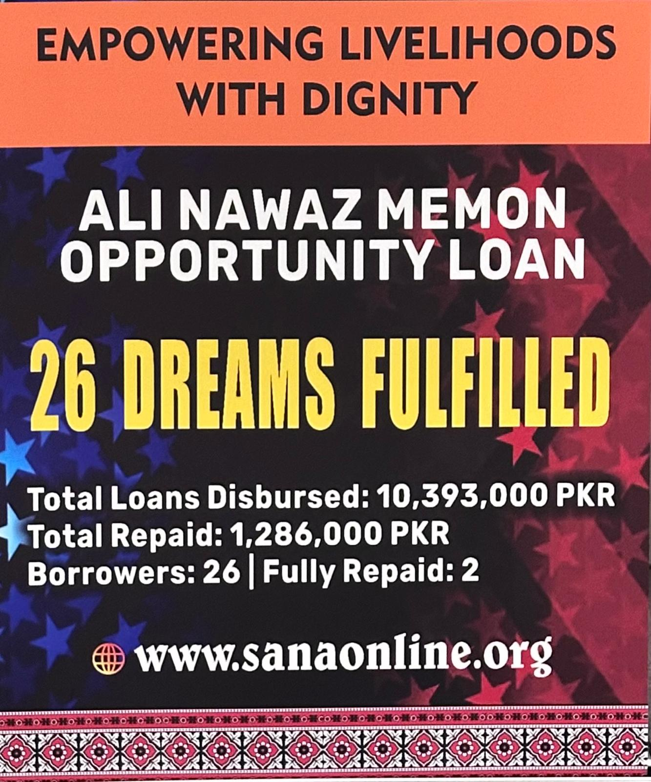
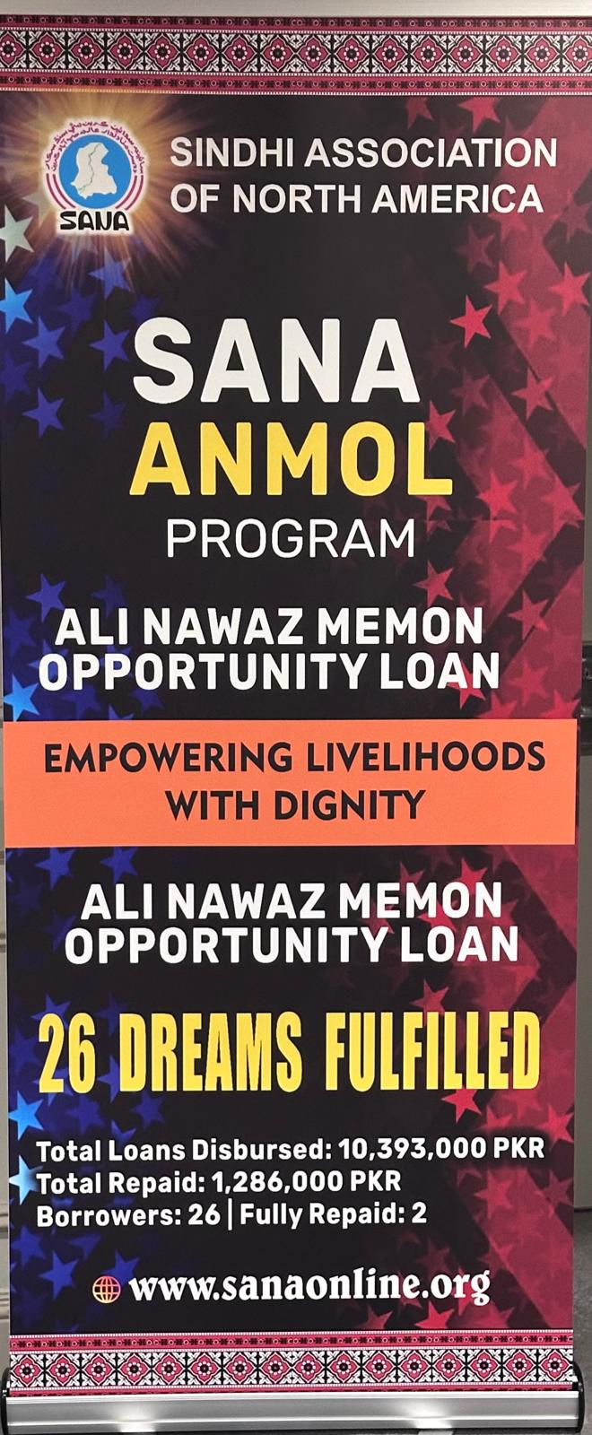

Slide 8
SANA - ANMOL GOALS
The program empowers entrepreneurial talent in Sindh by providing financial support to motivated individuals.
It focuses on careers in allied health, vocational trades, and information technology, enabling Sindhis to succeed in both domestic and international markets.
Creating Role Models among Sindhis

Slide 9
Topics I Will Cover Today
Program Structure – How the program is organized
Application Process – Steps to apply and participate
Eligibility & Requirements – Who can qualify
Record Keeping & Tracking – Ensuring transparency and accountability
Impact Stories – Real examples of how your donations make a difference

Slide 10
Structure Of The SANA-ANMOL Program
Healthcare-Vocational-Technical Education and Training
Business Start-Ups and Scale-Ups

Slide 11
Healthcare-Vocational-Technical Education and Training
Healthcare
Vocational and Technical
Information Technology
Marketable Computer Skills
Nurses
Xray Techs
MRI Techs
CT SCAN Techs
Clinical Laboratory Techs
And more
Plumbers
Electricians
Welders
Auto Mechanics
Beauticians
Hairdressers
And more
Security
Programming
Systems and networks
Data analysis
Cloud computing
Machine learning
And more

Slide 12
Business Start-Ups and Scale-Ups
Rickshaws
Repair workshops
Services
Beauty Parlors
Tailoring
Retail stores
And more

Slide 13
The SANA-ANMOL Application Process
Starts at the SANA website
English Form – Fully digital; completed online
Applications and attachments automatically stored in our database & spreadsheet
Sindhi Form – Available as a downloadable PDF document

Slide 14
Sample Of The Sana-Anmol Application Form Questionnaire
Full name of the applicant (as written on the CINC)
Loan amount requested (Pakistani Rupees)
CNIC Number
Date of Birth (DD/MM/YYYY) (as written on the CINC)
Marital Status
Cell Number
Residential PTCL
Present address (as written on the CINC)
Permanent address (as written on the CINC)

Slide 15
Sample Of The Sana-Anmol Application Form Questionnaire
How much monthly instalment you will pay and when will you start paying the loan installment?
Name address, phone number, and CNIC number of their father/mother/spouse
How do you intend to utilize the loan funds?
Please list your skills, experience, and employment/business history of the last five years (names of employers, designations/job titles, duties, dates, and names of supervisors for each position).
Your experience in the relevant field.
Explain what efforts you have made to accomplish your goals

Slide 16
Selection of the Applicants
Applications are carefully reviewed with emphasis on:
Motivation & Effort – proven commitment
Relevant Experience – background in the field
Initiative & Drive – personal leadership
Financial Need – genuine support required
Personal Investment – own contribution to the project
Employment Potential – ability to secure a job or generate income
Recommendations – endorsements from SANA members or trusted references

Slide 17
Decision Making Process
All committee members have access to SANA-ANMOL digital records
Initial Review – Each member reviews applications and adds comments
Committee Discussion – By majority decision, the committee may:
    Request more information
    Schedule a Zoom or WhatsApp interview
    Reject the application
Voting – Members cast a final Yes/No vote
Final Step – Decision is communicated to the applicant

Slide 18
Requirements After Loan Approval
Affidavit on Stamp Paper – Signed and stamped by a practicing attorney (not Oath Commissioner) stating:
  Applicant is not involved in any illegal activity
  Mutually agreed repayment arrangement
  Four witnesses with copies of their CNICs
  Attorney’s name, address, and phone number

Slide 19
Loan Disbursement
Approval PDF FILE sent to the SANA Treasurer, including:
Applicant’s personal details (addresses, phone numbers, family info)
Copy of CNIC
Copy of affidavit
Bank account information
Treasurer’s Role – Oversees and completes the disbursement of funds

Slide 20
Loan Payment Instructions
Payment Instructions – Applicants receive details of where to deposit installments
Proof of Payment – Applicants must send a copy of each deposit slip to the Committee
Tracking & Reporting – Committee enters payments into the database, which generates progress and recovery reports

Slide 21
2023 Donations
Aijaz Memon | $500
Dr Khalid Memon | $500
Dr Maqbool Halepoto | $1,000
Farnaz Halepoto | $1,000
Hasnain Shaikh | $1,000
Jamil Daudi | $200
Kamran Memon | $5,000
Maqbool Soomro | $100
The ANMOL Program is Profoundly Thankful to The Donors for Changing Lives of Many Sindhis

Slide 22
2023 Donations
The ANMOL Program is Profoundly Thankful to The Donors for Changing Lives of Many Sindhis
Mushtaq Rajpar | $500
Sammi Memon | $300
Sarfraz Memon | $1,000
Shahmir Halepoto | $1,000
Zahid Shaikh | $500

Slide 23
2024 Donations
Aijaz Turk | $1,000
Asghar Pathan | $200
Dr Khalid Memon | $500
Dr Maqbool Halepoto | $1,000
Farnaz Halepota | $1,000
Habib Bhutto | $200
Hasnain Shaikh | $1,000
Iqbal Tareen | $200
The ANMOL Program is Profoundly Thankful to The Donors for Changing Lives of Many Sindhis

Slide 24
2024 Donations
Jabbar Siddiqi | $100
Jamil Daudi | $500
Kamran Memon | $2,000
Mansoor Qurashi | $100
Mazhar Lakho | $500
Mithal Vikkasi | 500
Sani Panhwar | $1,000
Sarfraz Memon | $1,000
The ANMOL Program is Profoundly Thankful to The Donors for Changing Lives of Many Sindhis

Slide 25
2024 Donations
The ANMOL Program is Profoundly Thankful to The Donors for Changing Lives of Many Sindhis
2024 Total Donations USD |  | $13,100
2024 | Shafqat Memon PkR | 300,000

Slide 26
2025 Donations
The ANMOL Program is Profoundly Thankful to The Donors for Changing Lives of Many Sindhis
2025 | Awais Panhwar | $500
 | Dr Maqbool Halepoto | $1,000
 | Razia Memon | $2,000
 | Sarfraz Memon | $1,000
 | Jamil Daudi | $500

Slide 27
2025 Donations
What happened to my hard-earned money I donated to the ANMOL Program?

Slide 28
Current SANA-ANMOL BUSINESS LOANS-August 2025
ID | Year | Loan Recipient Name Abbreviation | Loan Amount | Purpose
B01 | 2023 | Mr. MS | 40,000 | Purchase a passenger Chnchi
B02 | 2024 | Mr. MAK | 1,500,000 | Purchase a Taxi
B03 | 2024 | Mr. KR | 200,000 | Clothing business
B04 | 2024 | Ms. HBA | 500,000 | Open a beauty parlor
B05 | 2024 | Ms. SS | 500,000 | Open a beauty parlor
B06 | 2024 | Ms. SB | 50,000 | Commercial Sewing Machine
B07 | 2024 | Mr. MKB | 220,000 | Purchase a Loader Chnchi
B08 | 2024 | Mr. AAS | 300,000 | Commercial Sewing Machine
B09 | 2024 | Mr. JM | 400,000 | Inventory for the medical store

Slide 29
Current SANA-ANMOL BUSINESS LOANS-August 2025
ID | Year | Loan Recipient Name Abbreviation | Loan Amount | Purpose
B10 | 2024 | Mr. FAM | 500,000 | Open motors cycle repair shop
B11 | 2024 | Mr. SA | 500,000 | Complete construction of a school
B12 | 2024 | Ms. RB | 245,000 | Purchase a Cow
B13 | 2024 | Ms. KL | 280,000 | Purchase a Cow
B14 | 2024 | Ms. BA | 1,000,000 | Open a home based clothing store
B15 | 2024 | Mr. MK | 180,000 | Loader Rikshaw
B16 | 2024 | Mr. SH | 150,000 | Expand decoration business
B17 | 2024 | Ms. SWA | 1,000,000 | Start fertilizer production
B18 | 2024 | Ms. PK | 100,000 | Samosa Shop

Slide 30
Current SANA-ANMOL BUSINESS LOANS-August 2025
ID | Year | Loan Recipient Name Abbreviation | Loan Amount | Purpose
B19 | 2024 | Ms. AM | 200,000 | Start a tailoring Shop
B20 | 2024 | Mr. WA | 200,000 | Purchase a Loader Chinchi
B21 | 2024 | Mr. NK | 400,000 | Start a Garment & Cloth Shop
B22 | 2025 | Ms. FB | 300,000 | Purchase a Cow
B23 | 2025 | Ms. HBA | 300,000 | Purchase a Cow
B24 | 2025 | Mr. MA | 320,000 | Purchase a passenger Chnchi
B25 | 2025 | Mr. MAB | 500,000 | Purchasing fertilizer
B26 | 2025 | Mr. ZA | 300,000 | Purchasing fertilizer

Slide 31
Current SANA-ANMOL Education Loans-August 2025
ID | Year | Loan Recipient Name Abbreviation | Loan Amount (PkR) | Purpose
E1 | 2023 | Ms. SR | 150,000 | To complete her PhD degree.
E2 | 2023 | Ms. MM | 348,000 | Bachelor of science in Nursing (BscN) programe
E3 | 2024 | Mr. SK | 180,000 | To complete Masters degree in nursing along with Govt nursing instructor.
E4 | 2024 | Mr. IT | 1,000,000 | To complete Masters in Healthcare Management in Berlin, Germany
E5 | 2024 | Mr. SS | 250,000 | To complete advanced Health and Safety certifications, EBOSH IGC and OHSAS

Slide 32
SANA-ANMOL Cumulated 2023-July 2025 Financial Report
Loan Type | Number of loans | Loan Amount (PK Rupees)
Entrepreneur Loans | 26 | 10,185,000
Education Loans | 5 | 1,928,000
Total Loan |  | 12,113,000

Slide 33
SANA-ANMOL Cumulated 2023-July 2025 Financial Report
Loan Type | Number of loans | Loan Amount (PK Rupees) | Loan Recovery (PK Rupees)
Entrepreneur Loans | 26 | 10,185,000 | 1,836,000
Education Loans | 5 | 1,928,000 | 150,000
Total Loan |  | 12,113,000 | 1,836,000

Slide 34
SANA-ANMOL Cumulated 2023-July 2025 Financial Report
Total loan repayment collected (PkR) | Re-circulated for new loans (PkR)
1,836,000 | 1,655,565

Slide 35
SANA-ANMOL Cumulated 2023-July 2025 Financial Report
Current Balance in Pakistan | 180,435 (PkR)
Current Balance with SANA Treasurer | 4,615 USD

Slide 36
Let the evidence speak so loudly that words are unnecessary

Slide 37
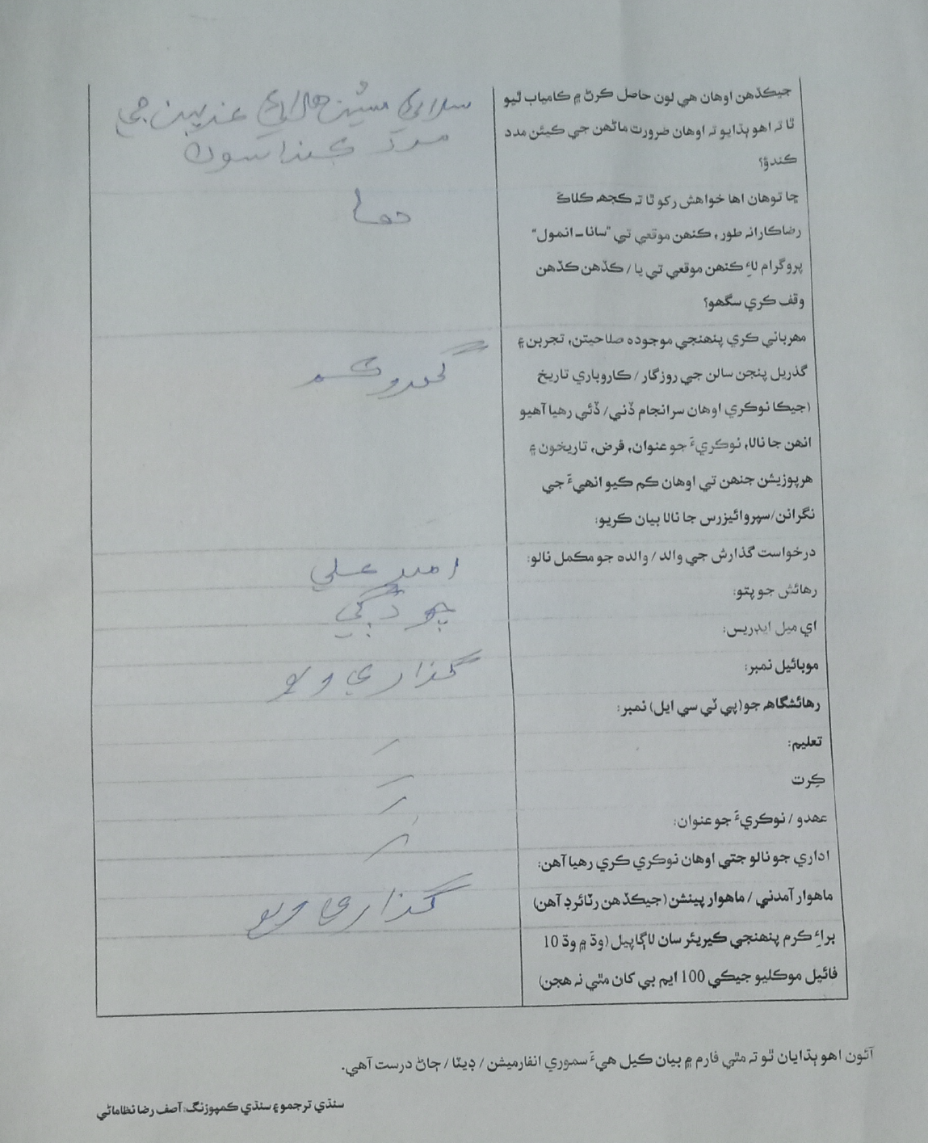
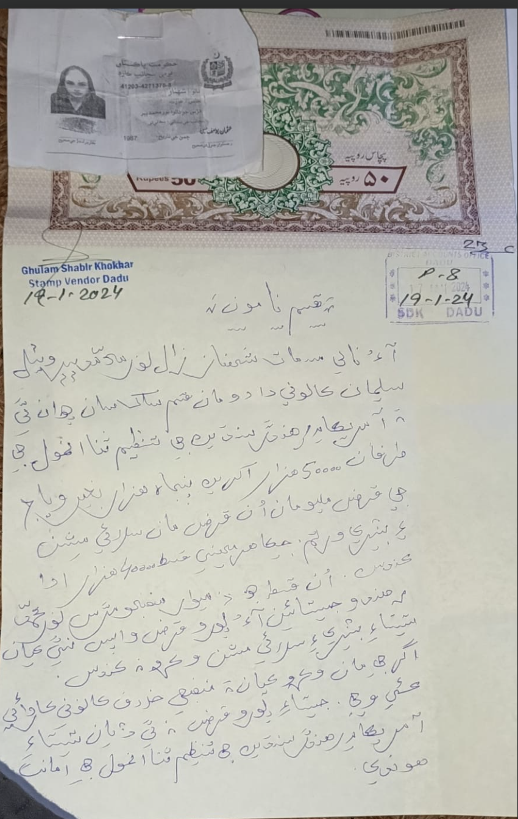
With tailoring skills from a local sewing center, she launched her home business through a 50,000-rupee SANA-ANMOL loan, enabling her to buy a commercial sewing machine with battery backup for uninterrupted work.

Slide 38

With tailoring skills from a local sewing center, she launched her home business through a 50,000-rupee SANA-ANMOL loan, enabling her to buy a commercial sewing machine with battery backup for uninterrupted work.

Slide 39
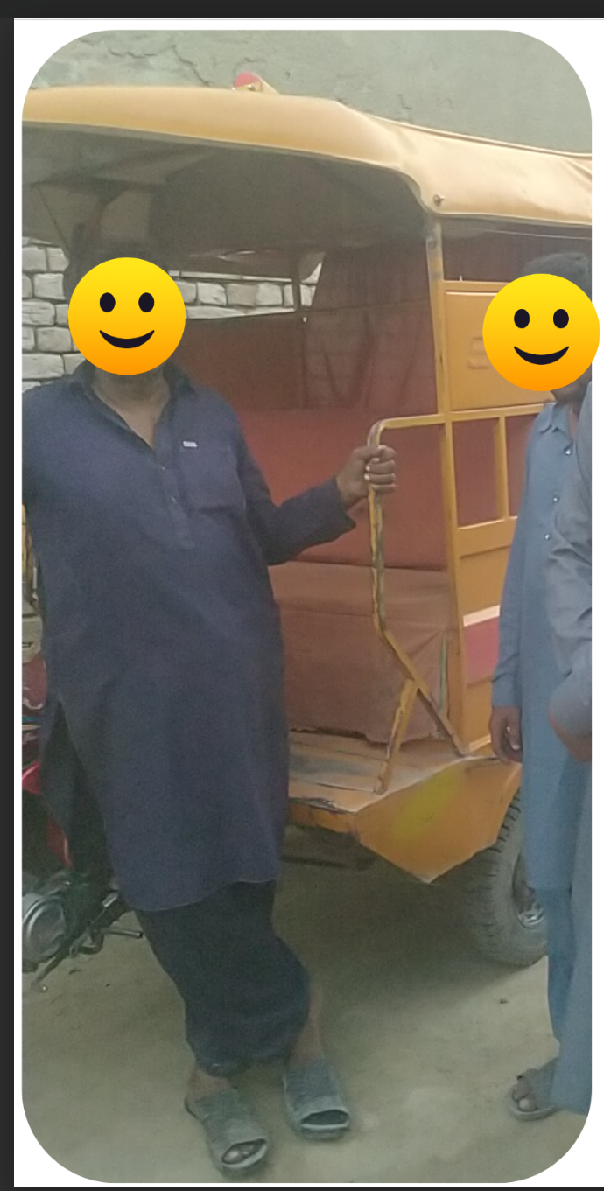
After selling his Chinchi to pay for his wife’s surgery, he was left without a livelihood. With his own savings and a 40,000-rupee loan from SANA-ANMOL, he was able to purchase a second-hand passenger Chinchi and restart his work.

Slide 40
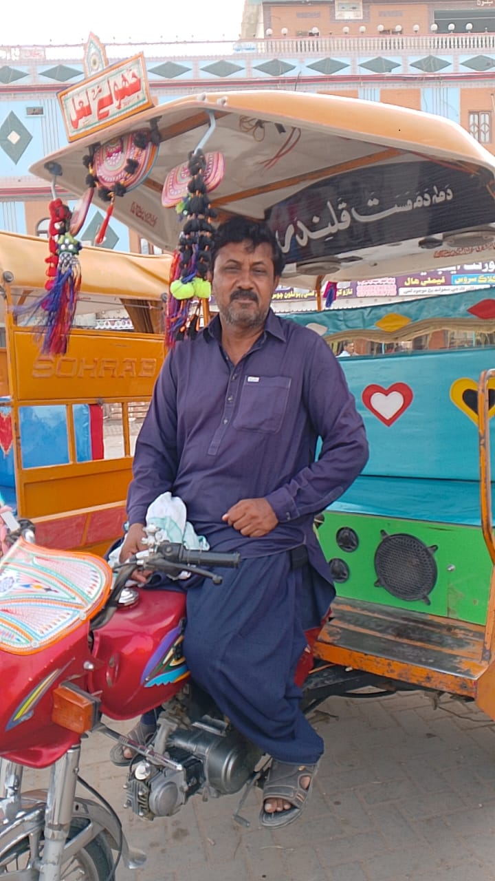
The day of purchase
June 21, 2024

Slide 41
The day of purchase
June 21, 2024

Slide 42
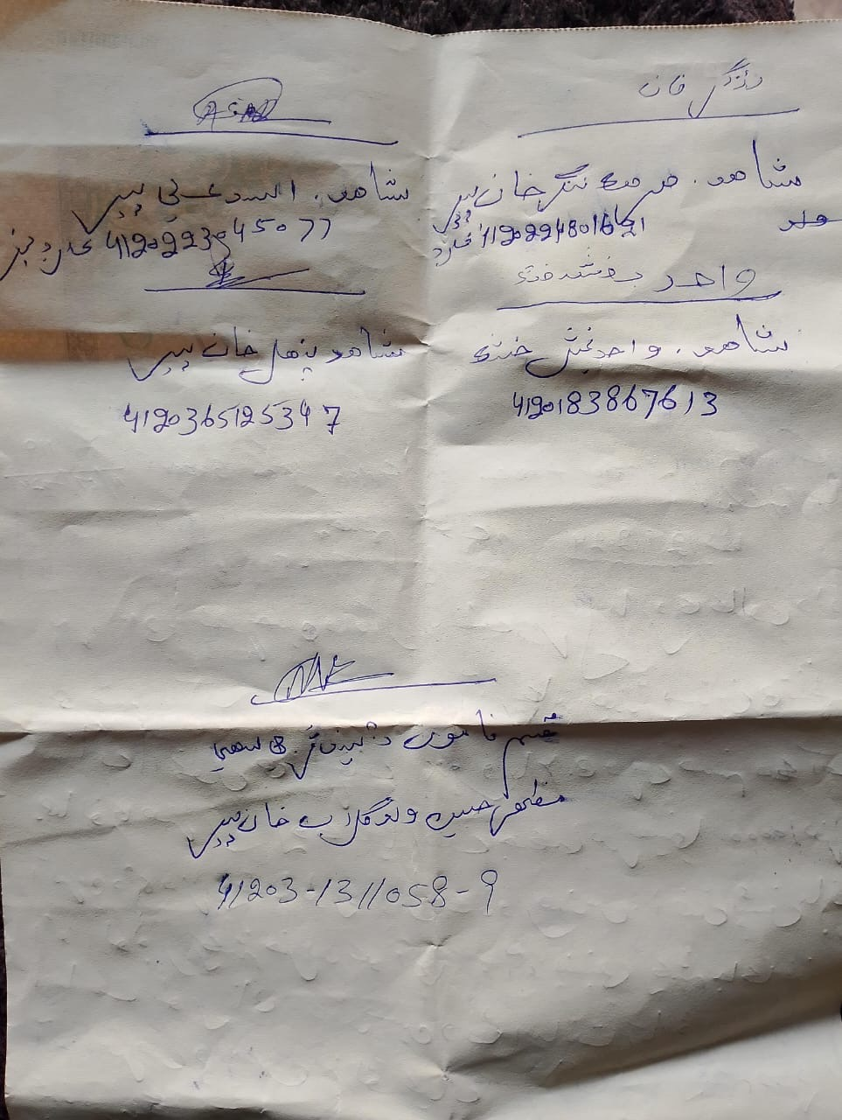
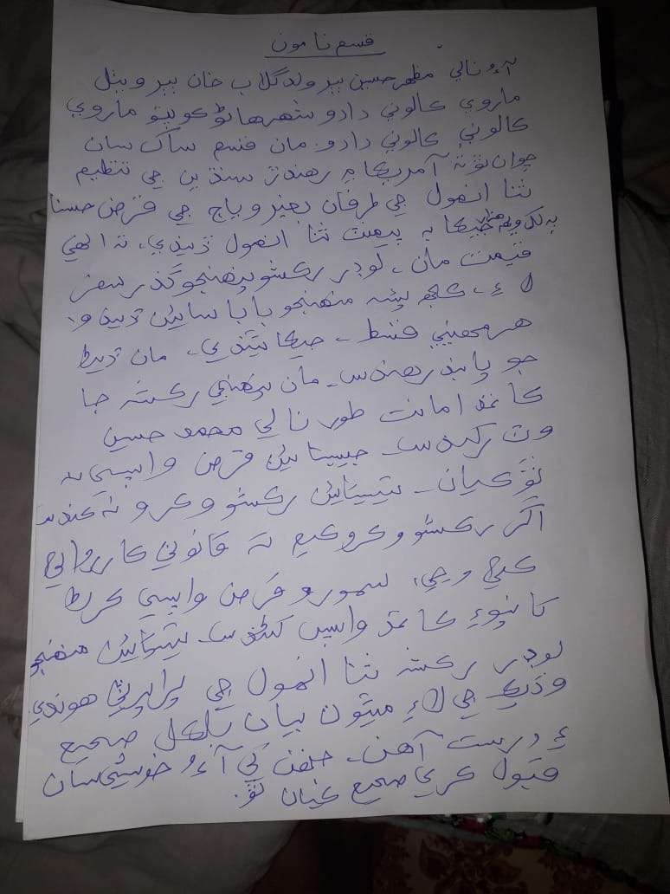
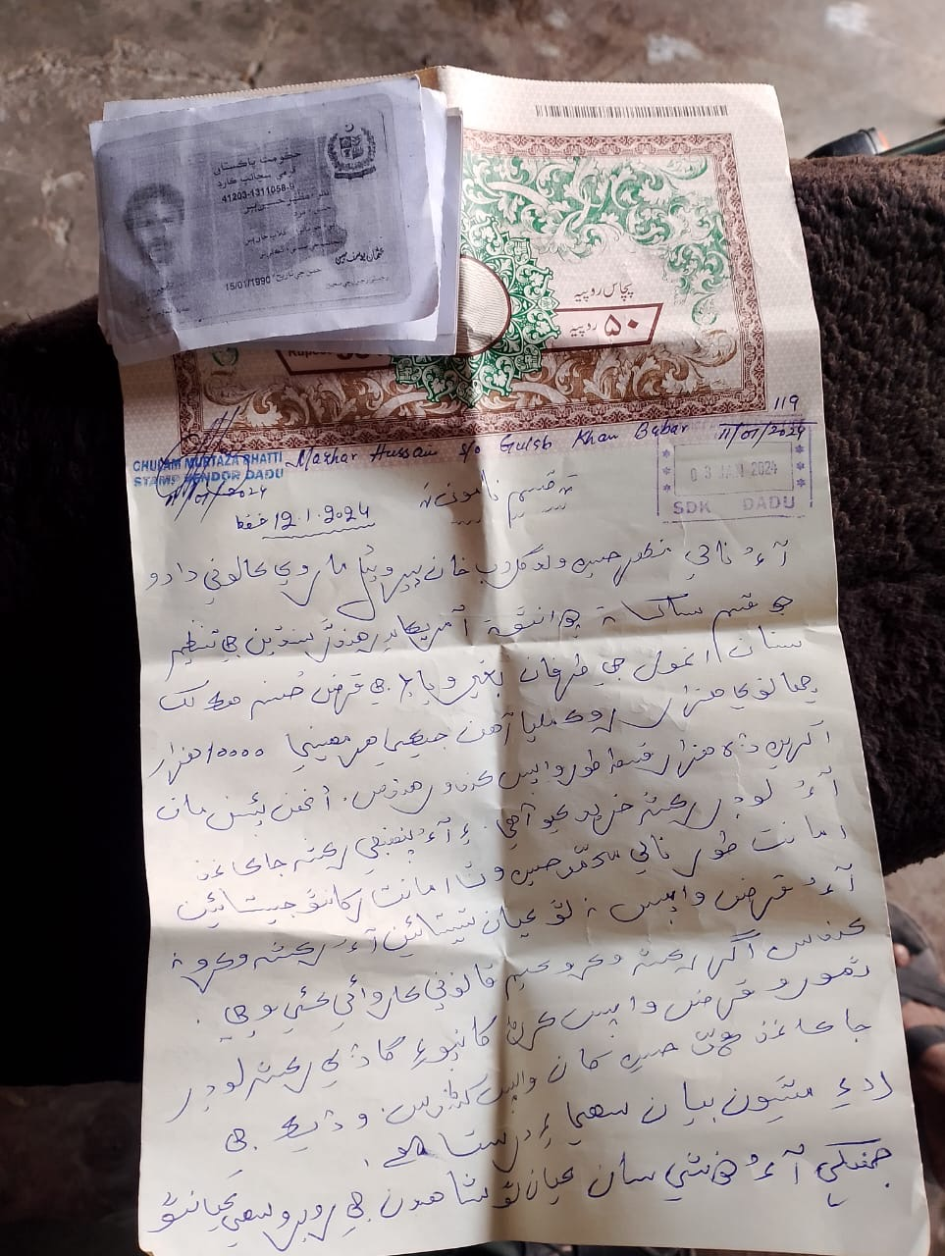

Slide 43
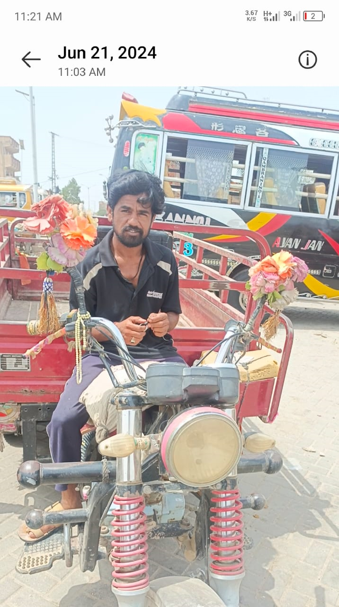
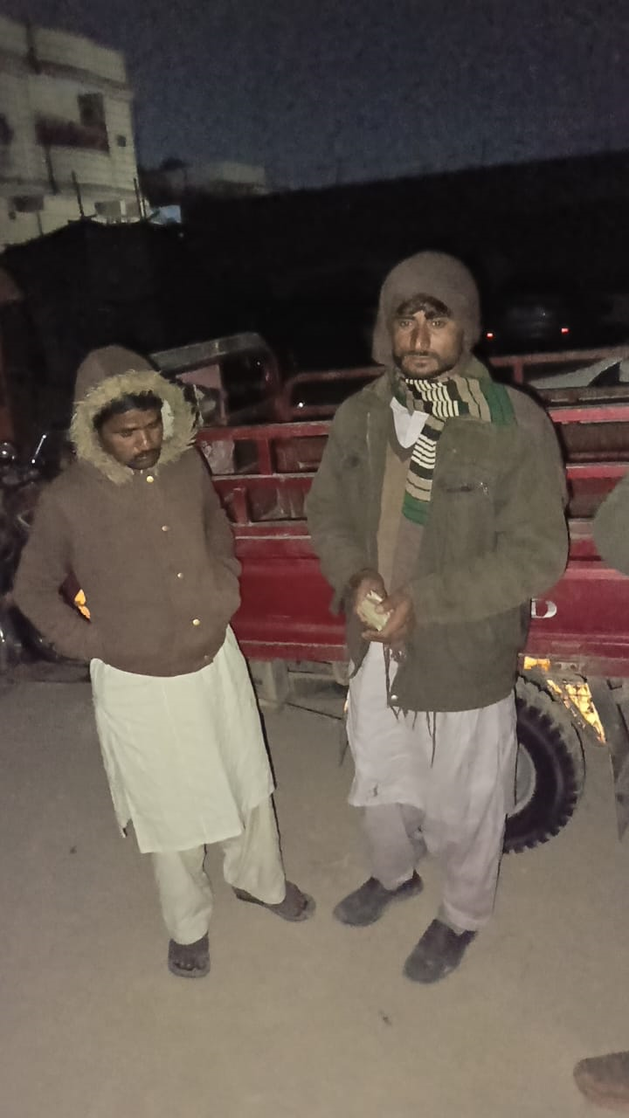
The day of purchase
June 21, 2024
Applicant’s father contributed 35,000 rupees, ANMOL approved loan of 220,000 rupees for the Loader Chinchi.
Already paid back 170,000 rupees

Slide 44
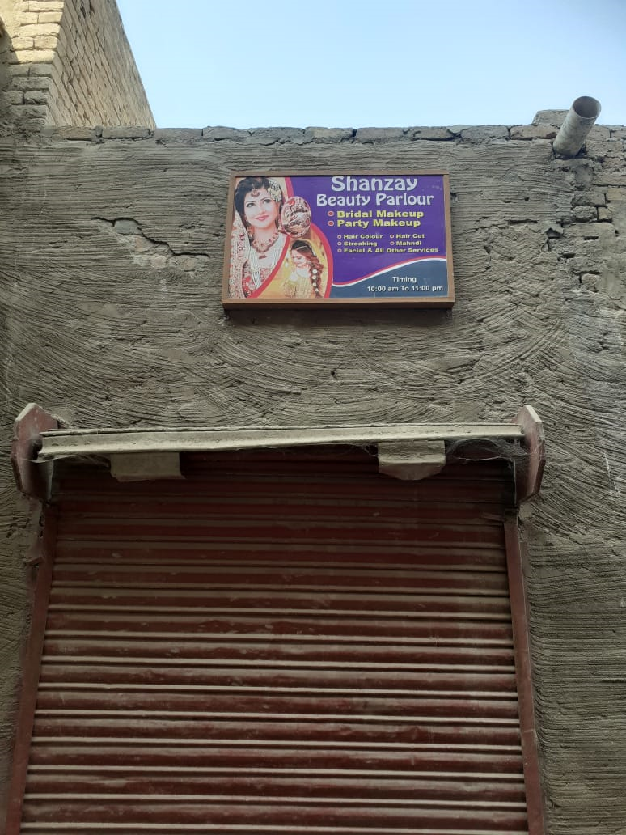
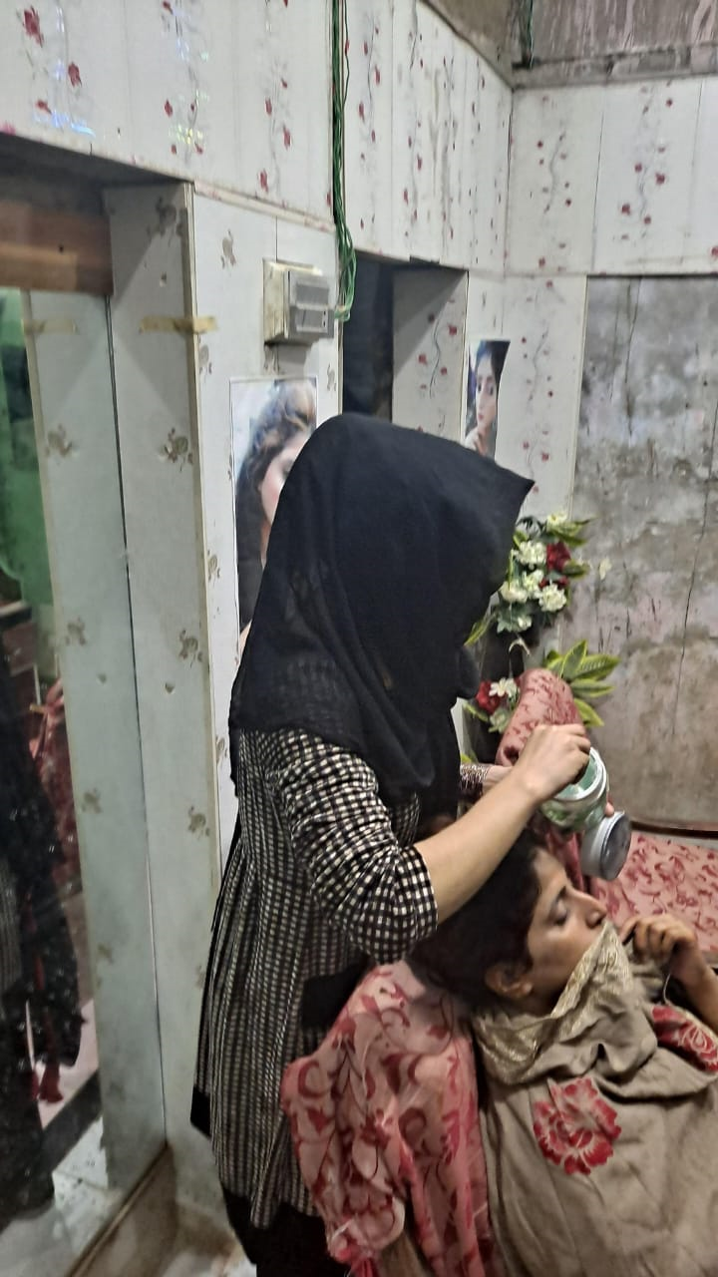

A trained and skilled beautician in Mehar, district Dadu, operated a modest beauty salon from a room within her home.

Slide 45
With a 500,000-rupee loan from SANA-ANMOL, she was able to establish her own professional beauty parlor.

Slide 46
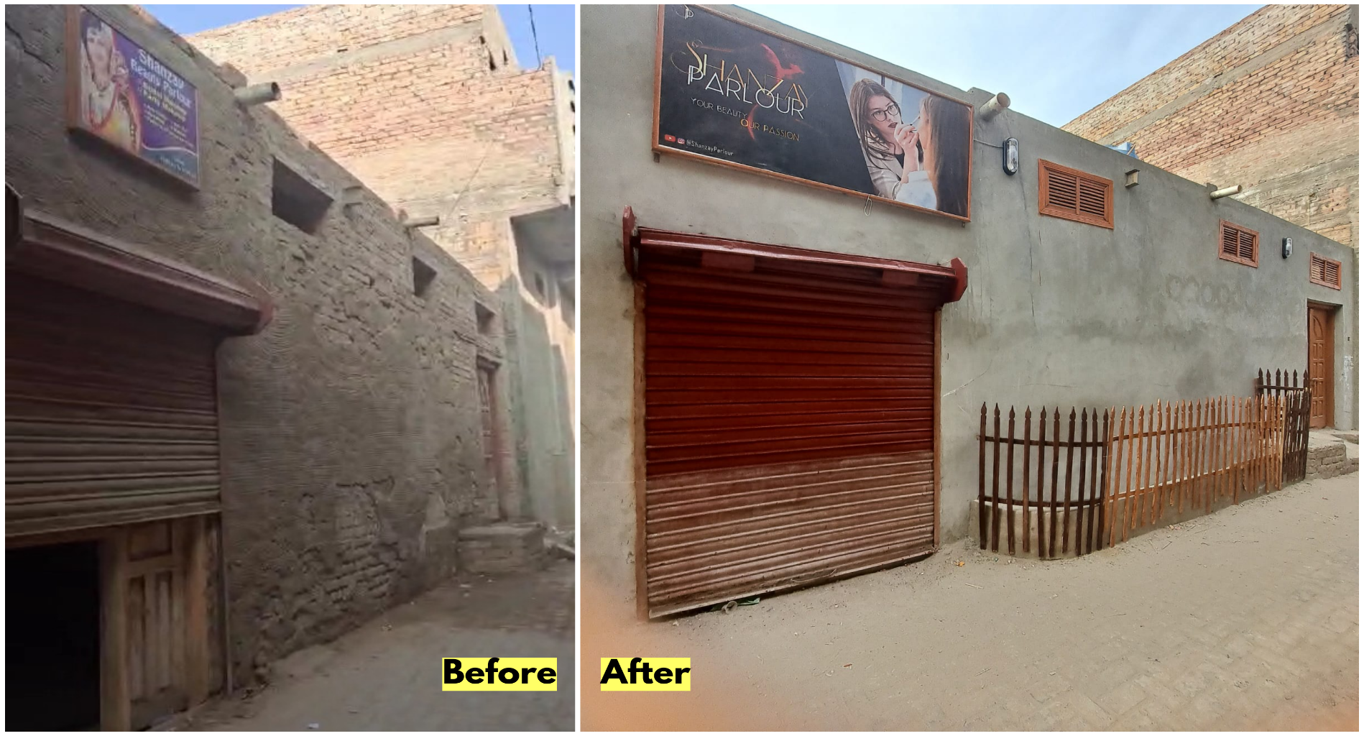

Slide 47
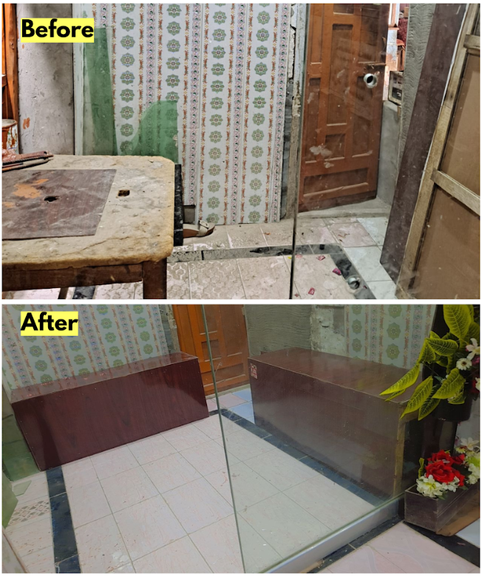
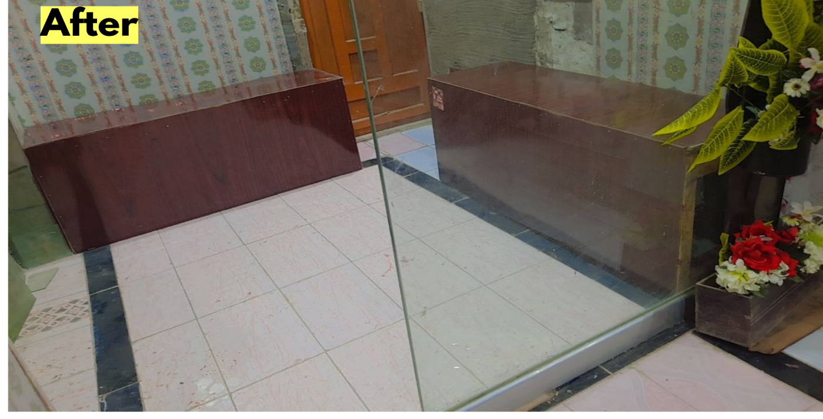

Slide 48
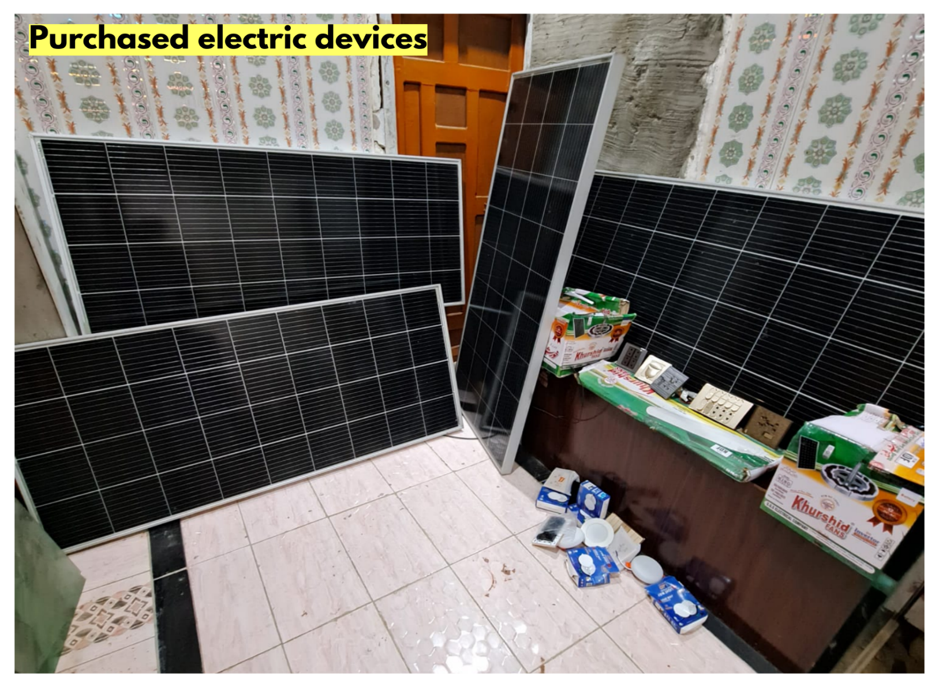


Slide 49
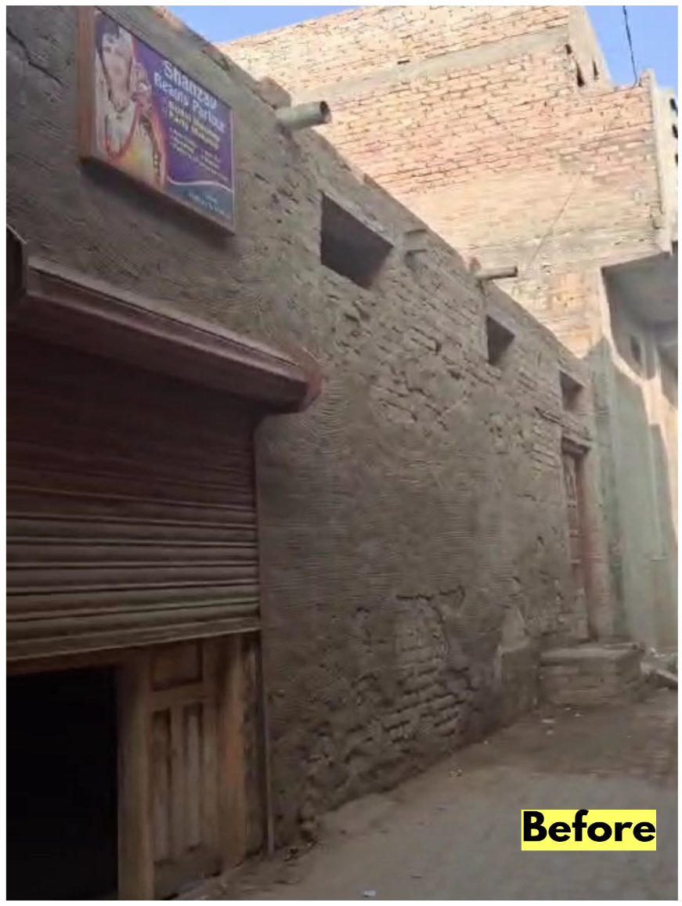
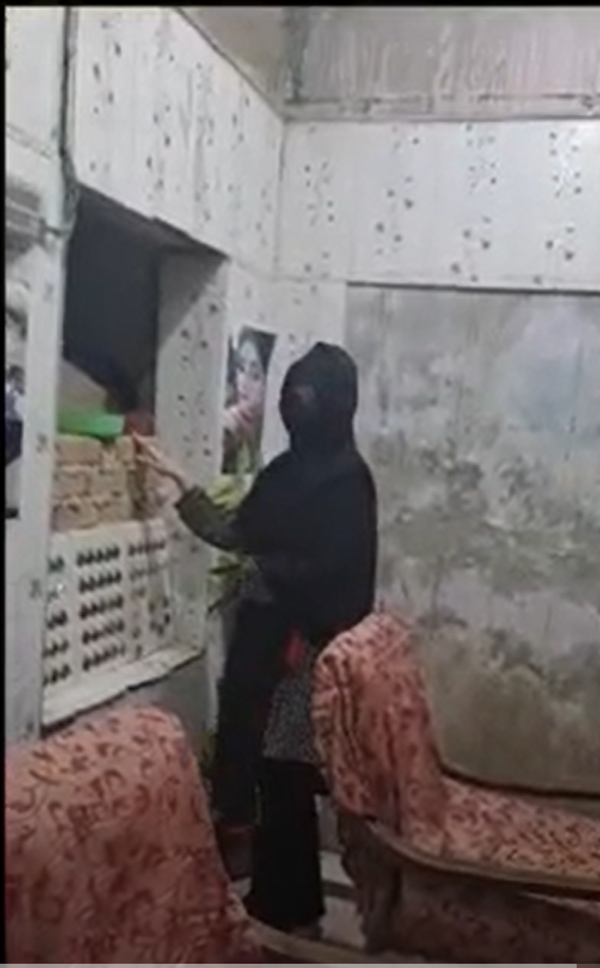
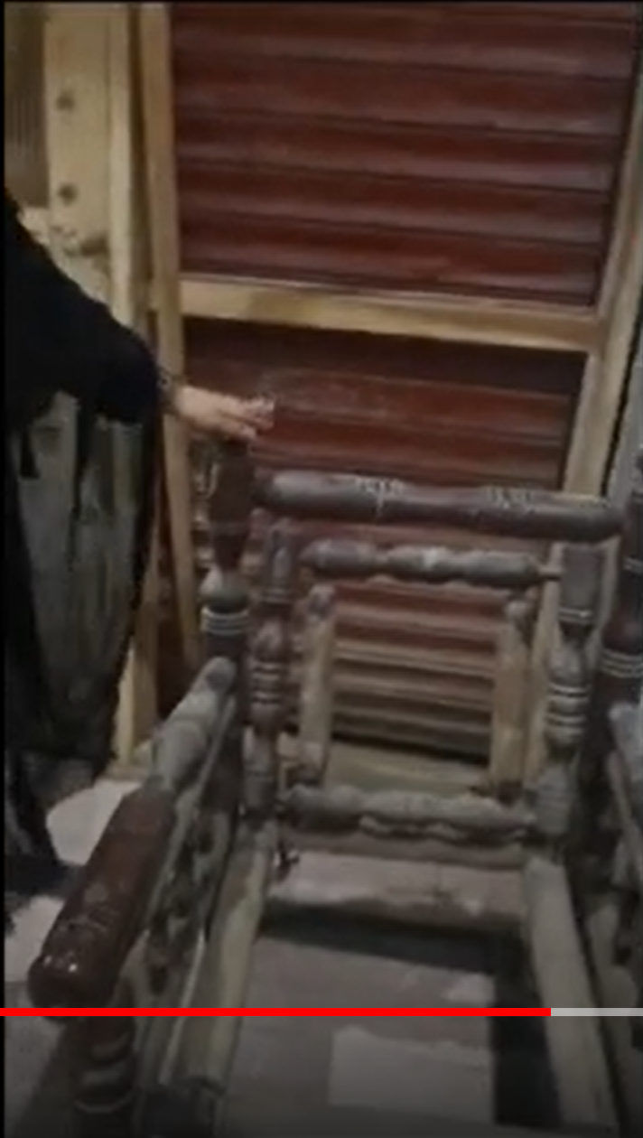
Mehar, district Dadu

Slide 50

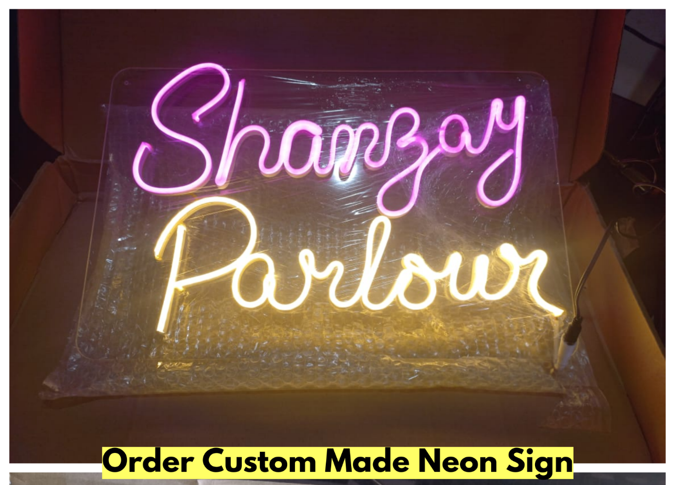
Already repaid 180,000 Rupees

Slide 51
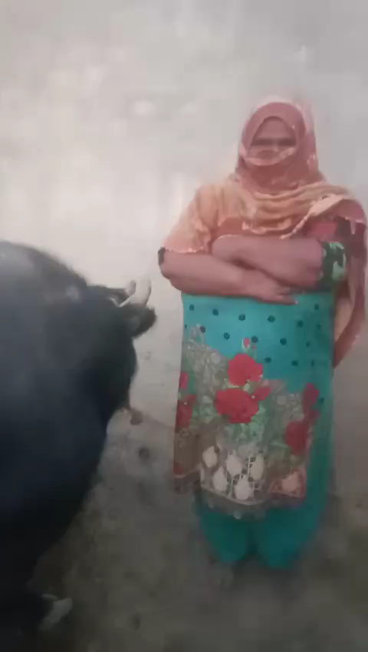
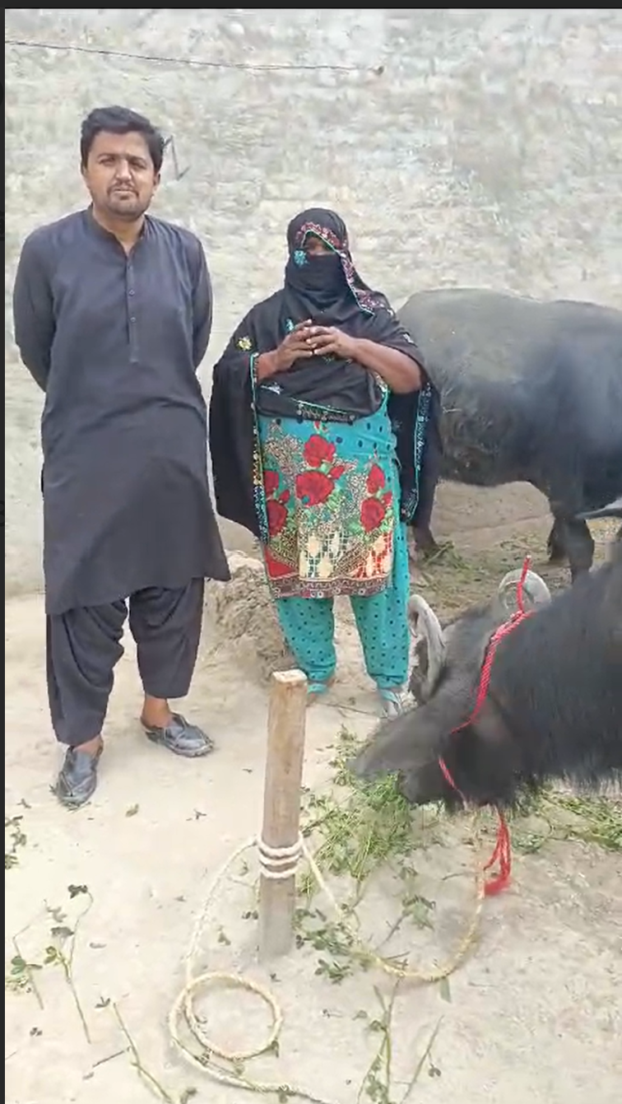
ANMOL approved loans of 240,000 Rupees to purchase a cow. She has already repaid 150,000

Slide 52
On Fri, Aug 15, 2025 at 12:40 PM Muneela Damani <muneeladamani@gmail.com> wrote:
Hello .
I hope you all are doing well.
Here is my last semester result.
I'm really thankful to SANA - ANMOL organization for supporting me in my academic journey.
Thank you
Kind Regards
Muneela Meghwar

Slide 53
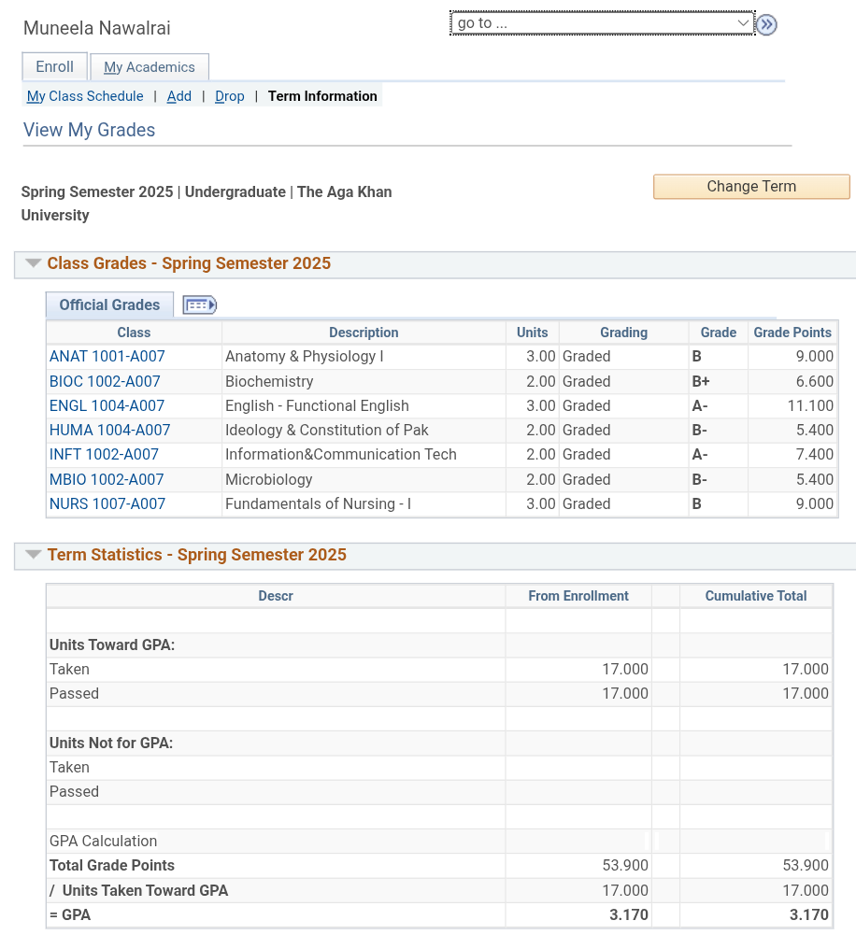

Slide 54

From: Sunny <sk2k220@gmail.com>
Date: Sat, Aug 16, 2025 at 12:00 AM
Subject: Re: Educational Progress Update Needed
To: SANA-Anmol Loans <sana.anmol.loans@gmail.com>A-o-A
Shukar Alhamdulillah all is well now I am currently enrolled in 7th semester I thankfully of SANA Anmol loan Members who's give me loan for cover my semester tuition fees
Thankyou.
On Fri, 15 Aug 2025, 9:29 pm SANA-Anmol Loans, <sana.anmol.loans@gmail.com> wrote:
Hi Sunny Kumar,
The SANA-ANMOL Program would like to receive an update on your educational progress, for which you were granted the loan.
--
Thank you.
Sarfraz Memon
Best regards,
SANA-ANMOL Program Committee
sana.anmol.loans@gmail.com

Slide 55
SANA-ANMOL PROGRAM COMMITTEE WANT TO THANK
Ahmer NADEEM MEMON (Canada)
Ghous Jatoi (Hyderabad)
Mohammad Hussain Babar (Dadu)
SVDP
FOR THEIR PRICELESS HELP TO THIS PROGRAM

Slide 56
THANK YOU FOR YOUR TIME AND ATTENTION
Now is the time to board the train and be part of a meaningful journey—supporting driven, talented, hardworking, and capable Sindhis who aspire to earn an honorable and dignified living while becoming role models for others.
Please donate generously to the SANA-ANMOL Program

